Slide 1
Consider Amazon……*SOME* Considerations
- Server issues - creation of RAID/backup systems
- Installation/Configuration of software
- Load balancing - how many accesses can we support?
- Denial of Service (DoS Attacks)
- Security/Encryption - SSL?
- Who is making the request? (proxies, ip)
- How do systems keep track of orders placed?
- Mutual exclusion issues - simultaneous accesses?
- Where is persistent data stored?
- Browser independence?
- JavaScript enabled/disabled
- End-user device - screen size, javascript support?
- Form validation - do we filter input? Do we allow html/tags?
- Accessibility / support for category users
- Internationalisation - seperate pages for each site?
FINALLY
- The software system implementation

Slide 2

Server-Side Development
Server-Side Introduction
Server-Side run on Server, Client-Side on Client
Examples: (Client) Executables, Applets, JavaScript
  (Server) CGI, PHP, Servlets, JSPs
Server-Side vs Client-Side
Advantages:
- Browser Independent (NB)
- Application Updates
- Code Protection
- Local file access (security)
Disadvantages:
- Server Resources

Slide 3
Server-Side Development
Server-Side Introduction
Web Sites can harness both client-side and server-side
Example: Form validation/javascript front-end
Many client issues, such as browser independence:
-> Concentrating on Server-side rather than client-side
We actually talk about Client/Server Systems
Client/Server Systems
Since 1990s information recognised as growing currency
Brought client/server systems to the forefront
Client/Server systems replacing mainframe systems

Slide 4
Server-Side Development
Client/Server Systems
“Client/Server represents a logical relationship between an entity (client) that requests a service from another entity (server) which provides a shared resource”
Same or Distinct Machines
Client -> multiple servers
Server -> multiple clients
Relationship conducted by means of ‘Transactions’
Well defined requests and responses
-> Client/Server = Cooperative Processing

Slide 5
Server-Side Development
Client/Server Characteristics
Service – typically separate machines, provider and consumer
Shared Resources – multiple clients, efficient resource use
Hardware/OS Independence – Java!
Asymmetrical Protocols – many-to-one relationship.
Clients initiate dialog with requests, servers passively wait
Message Based – interact through message-based (req/res)
Transparency of Location – Server transparent redirects
service calls, other tiers, databases
Scalability – (Horizontal): adding/removing client workstations
(Vertical) migrating/upgrading, load balancing, e.g Amazon
Data/Source Protection – both data and source files (JAD)
Client Processing – clients may be used for some processing

Slide 6
Server-Side Development
Client Attributes
Client process is “proactive”
Issues requests to the server
Typically begins and ends with the user’s session
Responsible for performing dialog with the user
Screen Handling
Menu/Command Interpretation
Data Entry/Validation
Help Processing
Error Recovery
Graphical Applications also: window handling, mouse/
keyboard entry, sound/video etc.

Slide 7
Server-Side Development
Server Attributes
Server process is “reactive”
Triggered by the arrival of requests from its clients
Typically runs regardless of whether clients are active
Reliability Major Issue – what happens if the server
goes down?
Served by Server Process itself or spawned slave process
(diagram on next slide)
Spawning allows the master process to receive/handle
multiple requests simultaneously
Server is “function-specific” – performs a set of predefined
transactions. Server takes request and performs required logic
to process the request. -> Transaction

Slide 8
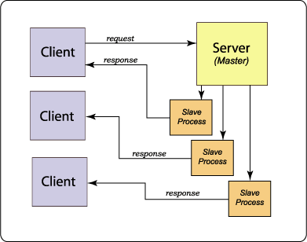
Server-Side Development
Master/Slave Processes

Slide 9
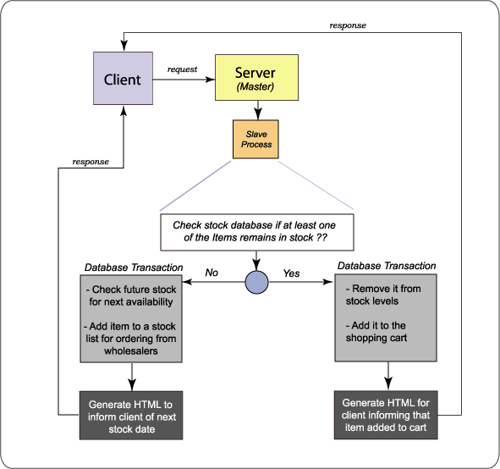
Server-Side Development
Server Transaction Example

Slide 10
Server-Side Development
Detailed Transaction Example
1. Log the transaction
  2. Decrease the stock levels of this item by 1
  3. Check if the stock levels have dropped below a certain level
  4. If stock has dropped below this level, email notify an employee or automatically place an order with the wholesaler
  5. Log this stock shortage
  6. Update database information on this customer, so that the "system" knows that the customer is interested in this genre of film
  7. Add the item to the users cart
  8. Perform checks on the users cart to check for 2 for 1 or reduced price combinations
  9. Generate the web page to return to the client

Slide 11
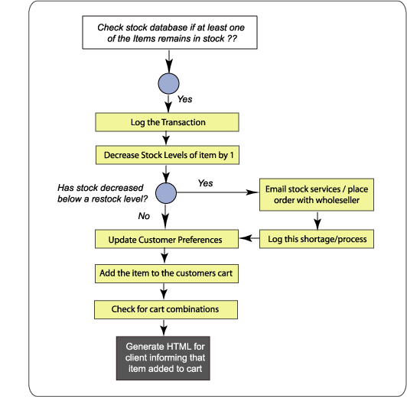
Server-Side Development
Detailed Transaction Example

Slide 12
Server-Side Development
Mutual Exclusion Issues
Server may simultaneously service numerous requests
Server must resolve mutual exclusion issues
Otherwise corrupt transactions/results/data
Server must ensure that either all or no updates occur
Consider example where two people attempt to buy
the last remaining DVD in stock

Slide 13
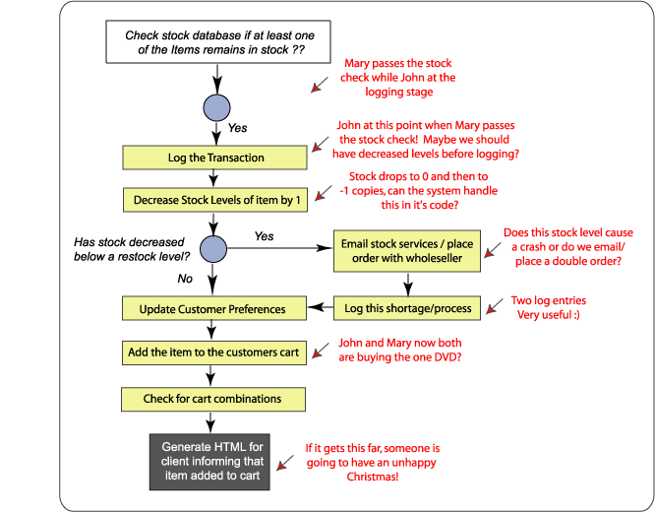
Server-Side Development
Concurrent Purchase Example

Slide 14
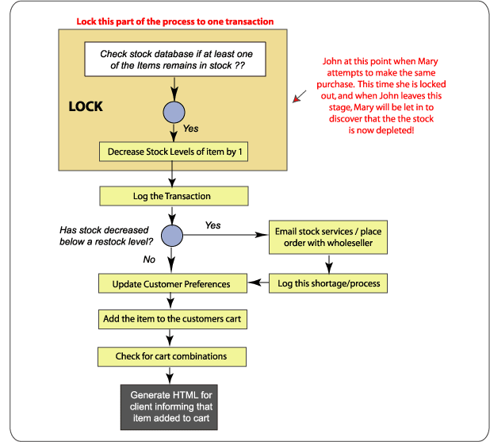
Server-Side Development
Concurrent Purchase - Solution

Slide 15
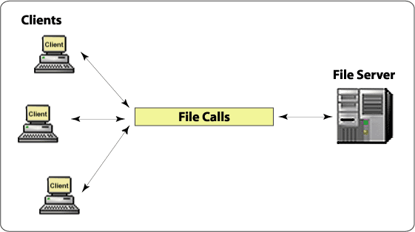
Server-Side Development
Client/Server Examples
File Servers
Processes requests for files/records on a remote server
Server holds a repository of documents, images and data
FTP could be regarded as a File Server

Slide 16
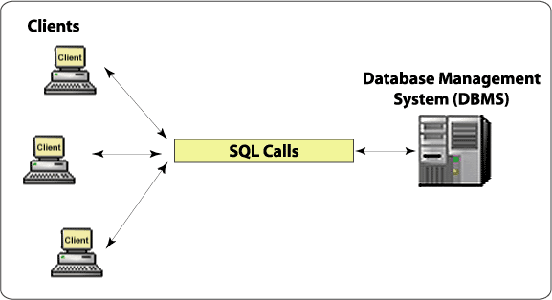
Server-Side Development
Client/Server Examples
Database Server
Client passes SQL (structured query language) as
messages to the database server
Server returns back the data that the client requests only

Slide 17
Server-Side Development
Client/Server Examples
Transaction Server
Client invokes ‘remote procedures’ that reside on the
server
These ‘remote procedures’ consist of groups of SQL
statements, which define a ‘transaction’
1 request / 1 response (unlike database server)
Statements succeed or fail as a combined unit
Client->GUI Server-> Online Transaction
Processing (OLTP)
OLTP applications mission-critical, fast, secure etc.
OLTP sometimes called TP-Lite or ‘Stored Procedures’
Stored Procedure is a collection of SQL statements and
logic which is compiled, verified and stored on the server

Slide 18
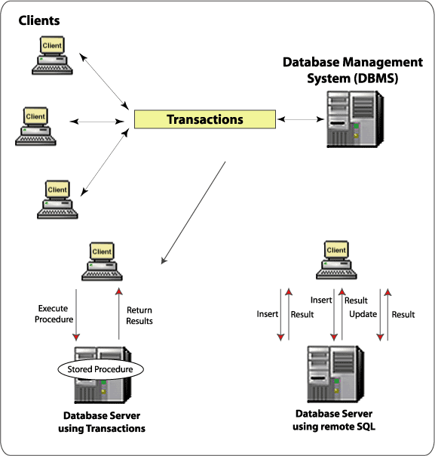
Server-Side Development
Client/Server Examples
Transaction Server

Slide 19
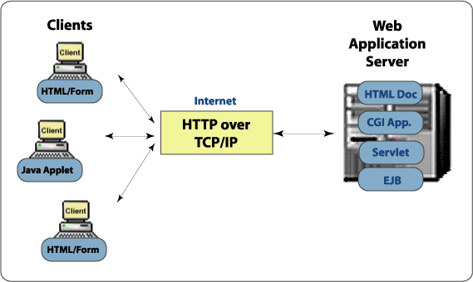
Server-Side Development
Client/Server Examples
Web Application Servers
Fastest growing client/server model
Thin, portable, universal clients talking to ‘superfat’ servers
Web Servers -> Full blown Web Application Servers
Communication via HTTP (RPC-like)

Slide 20
Server-Side Development
Client/Server Tiers
P-A-D Architecture
Client/Server physical architectures typically categorized in
terms of ‘tiers’
First we consider P-A-D, a fundamental logical model
- Presentation (user interface)
- Application (application logic)
- Data (data management)
Some models divide the application layer into three sublayers,
representing the interfaces with presentation & data layers
- Presentation Logic (interfacing with the UI)
- Business Logic (core of applicaton -> business rules)
- Data Logic (interfacing with the DBMS)

Slide 21
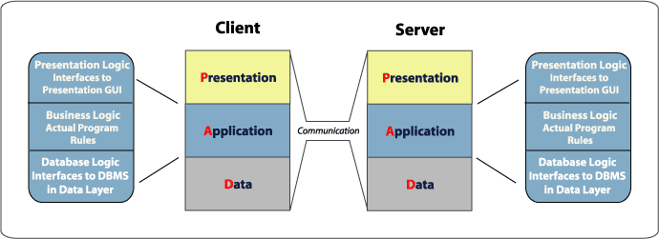
Server-Side Development
Client/Server Tiers
P-A-D Architecture
Three possibilities:
The system is performed totally on the client (Client-Side System)
The system is cooperatively split between the client and server (Client
/ Server System)
The system is performed totally on the server (Server-Side System)

Slide 22
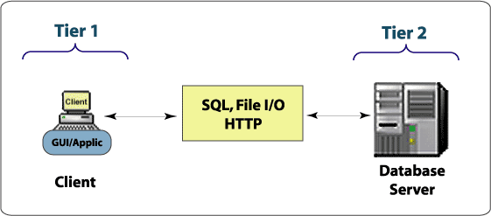
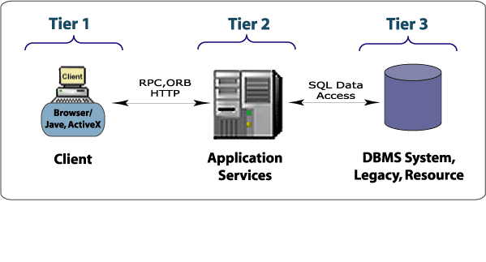
Server-Side Development
2-Tier vs 3-Tier Architecture
2-Tier Client/Server System
Simple
FAT Clients – business/application
logic typically on the client
Most suitable for departmental apps
2-Tier systems less suitable as they
globalise, change requirements or
become more advanced
“Gillette” 3 is better than 2!
3-Tier Client/Server System
More Complex
Scalable, robust, flexible
Presentation delivered on client
Business Logic on Tier 2 (one or
more servers)
Database logic on one or more
database servers
Client does not interact with
database directly, but via business
logic in Tier 2 -> better security

Slide 23
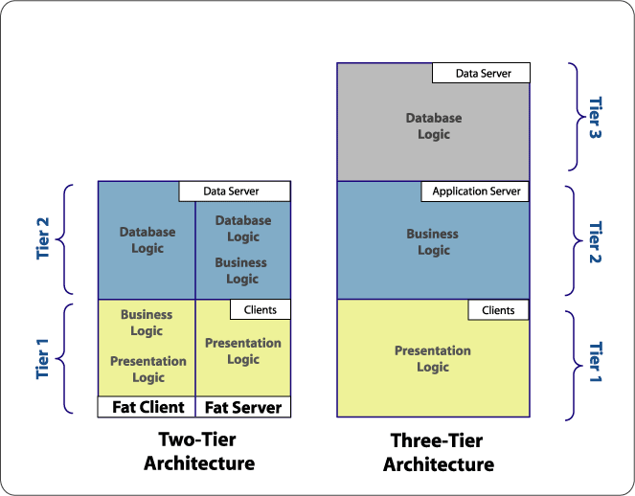
Server-Side Development
2-Tier vs 3-Tier Architecture

Slide 24
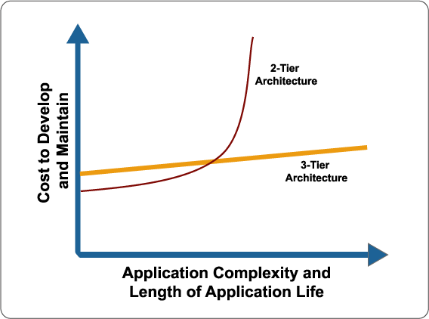
EE448: Server-Side Development
2-Tier vs 3-Tier Architecture

Slide 25
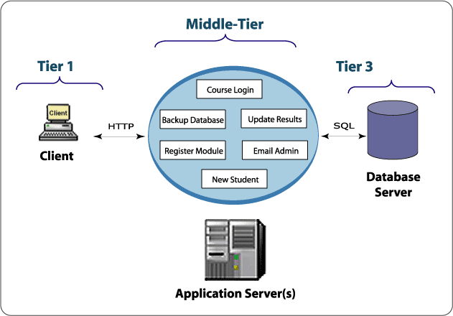
Server-Side Development
n-Tier Architecture
3-Tier often referred to as n-tier client/server architectures
Typically the middle tier is not a single application – rather a
collection of components
Each component implements a relatively small business function
-> Each transaction is the product of several middle-tier components

Slide 26
Server-Side Development
n-Tier Architecture
Component-Based
Applications can be written in smaller stages and released as
functionality becomes available.
No application need be considered “final” (add components later!)
Different programmers can work on individual components and
“plug” them together – can use “off-the-shelf” components
Individual components can be reused for different functionality or
applications
- Java source code reuse
- Compiled “binary black boxes”
Components provide a new level of abstraction. Clients send
requests to components to execute functions on their behalf.
Databases security and schemas are hidden from clients

Slide 27
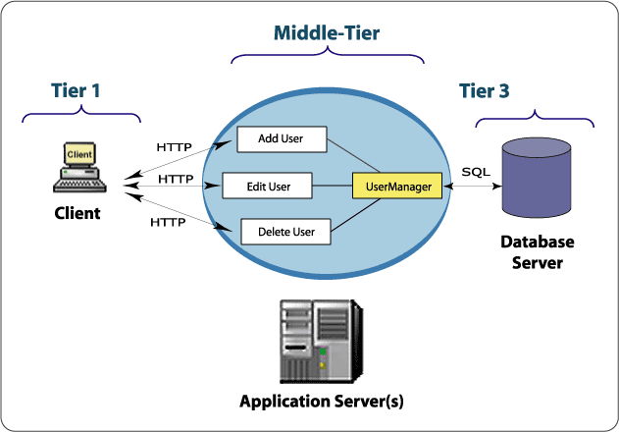
Server-Side Development
n-Tier Architecture
Component-Based
Component architecture provides consistent, secure access to data
and eliminates random, uncontrolled updates from many applications
at once. For example:

